Slide 1
ReactJS
The future of web development

Slide 2
ReactJS {contents}
JSX
Virtual-DOM
Props
PropTypes
State
Refs
LifeCycle
Flux Architech
Thinking in React
Routing

Slide 3
ReactJS {JSX}
JSX is a JavaScript syntax extension that looks similar to XML.
Concise and familiar syntax for defining tree structures with attributes.
Make large trees easier to read than function calls or object literals.
Can be used in both HTML tags and Components.

Slide 4
ReactJS {Virtual-DOM}
Problem:
DOM manipulation is expensive.
Re-render all parts of DOM make your app slowly.
When the component’s state is changed, React will compare with DOM element to make smallest change.
Is made by React.createElement().
https://www.youtube.com/watch?v=BYbgopx44vo

Slide 5
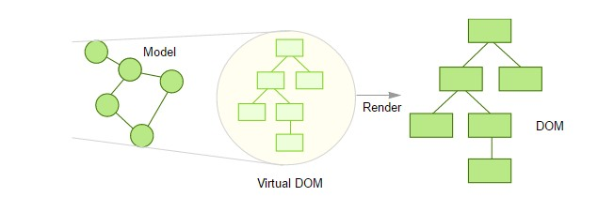
ReactJS {Virtual-DOM}
Only diff changes from the two V-DOMs are applied to real DOM

Slide 6
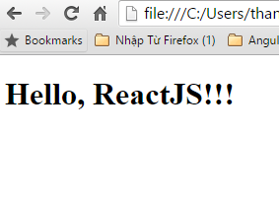
ReactJS {props}
Used to pass parameter from parent to children.
var HelloReact = React.createClass({ render: function() {
return (
<h1> Hello, {this.props.name} </h1>
);
}
});
ReactDOM.render(<HelloReact name="ReactJS!!!" />, node);

Slide 7
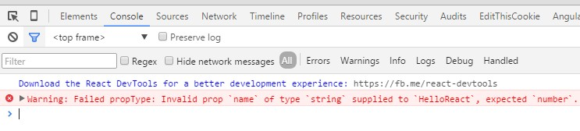
ReactJS {PropTypes}
For validate the prop’s value input.
var HelloReact = React.createClass({
propTypes: {
name: React.PropTypes.number
},
render: function() {
return (
<h1> Hello, {this.props.name} </h1>
);
}
});
ReactDOM.render(<HelloReact name="thanh" />, document.getElementById('content'));

Slide 8
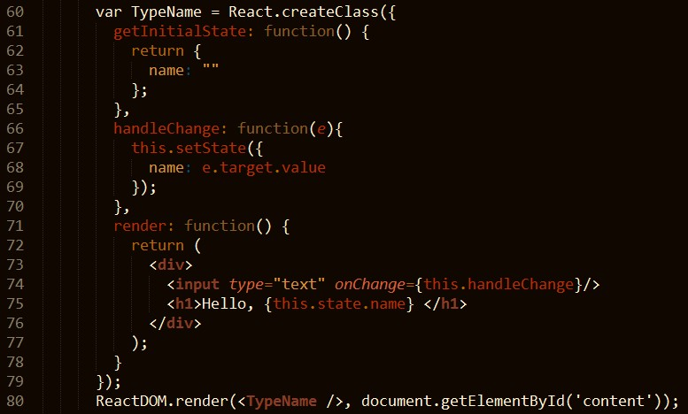
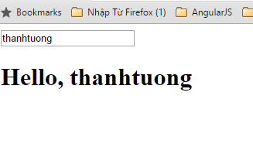
ReactJS {state}
To manage state inside component.
getInitialState() function: init value for variable.
setState() function: update new value for variable.

Slide 9
ReactJS {LifeCycle}
Each component has its own lifecycle events.
Ex:
If we wanted to make an ajax request on the initial render and fetch some data, where would we do that?
If we wanted to run some logic whenever our props changed, how would we do that?
 …
LifeCycle events

Slide 10
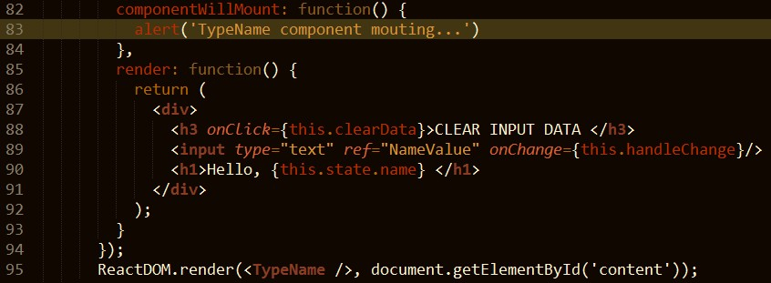
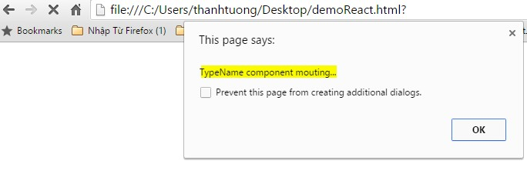
ReactJS {LifeCycle (cont)}
componentWillMount
Invoked once (both on the client and server ) before the initial render.
Good place to make connection to your db service (ex: firebase,...)
Do not call set state method here.

Slide 11
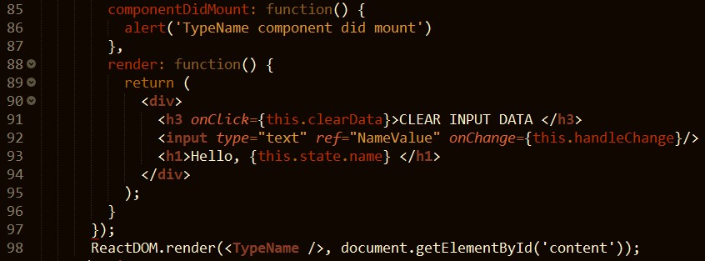
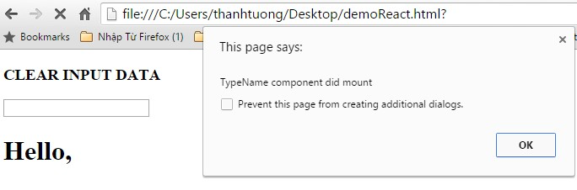
ReactJS {LifeCycle (cont)}
componentDidMount
Invoked once, only on the client (not on the server).
Immediately after the initial rendering occurs.
It is good place for you to make AJAX request to fetch data for first used.

Slide 12
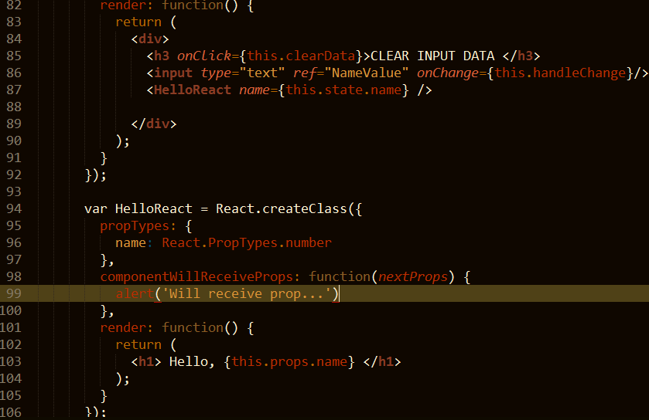
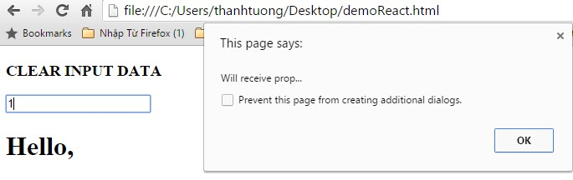
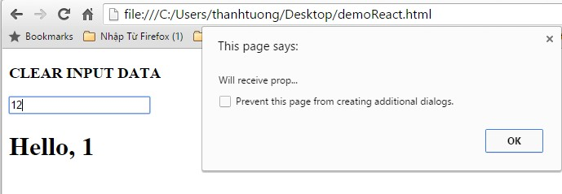
ReactJS {LifeCycle (cont)}
componentWillReceiveProps
Invoked when a component is receiving new props.
This method is not called for the initial render.
Use this method as a way to react to a prop change before render() is called by updating the state with setState.
Thanh Tuong | ReactJS | 2016

Slide 13
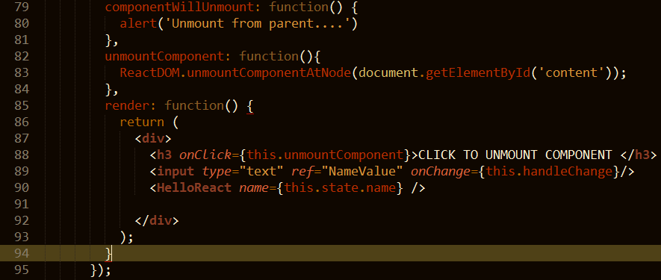
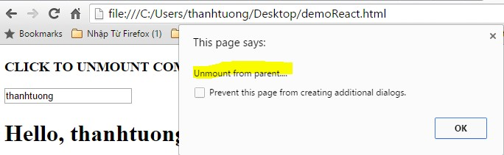
ReactJS {LifeCycle (cont)}
componentWillUnmount
Invoked immediately before a component is unmounted from the DOM.
Perform any necessary cleanup in this method(Ex: invalidating timers, clear up DOM elements were created at componentDidMount)
!!!

Slide 14


ReactJS { thinking in… }
How can I break it?
How many components should I have?

Slide 15




ReactJS { thinking in… }
5
1
5
5 1
4
FilterableProductTable: contains the entirety of the example
₄SearchBar: receives all user input
ProductTable: displays and filters the data collection based on user input
4
2
2
ProductCategoryRow: displays a heading for each category
3
3
ProductRow: displays a row for each product
2
3

Slide 16
Thank You.!

